Slide 1


ALGORITHMIC TRADING MODEL FOR
BTC/USDT Crypto Market
TEAM NAME - BORED FROM LUDO

Slide 2



Table
Of Contents
1
Introduction
4
Training ML Models
2
EDA
5
Trading Strategy
3
Feature Engineering
6
Backtesting Results
7
Risk managment

Slide 3
Introduction
The problem involves developing algorithmic trading strategies for the BTC/USDT cryptocurrency market, aiming to outperform benchmark(buy and hold) returns. Participants are required to create trading algorithms that can generate returns while managing risk effectively in the specific BTC/USDT market.

Slide 4
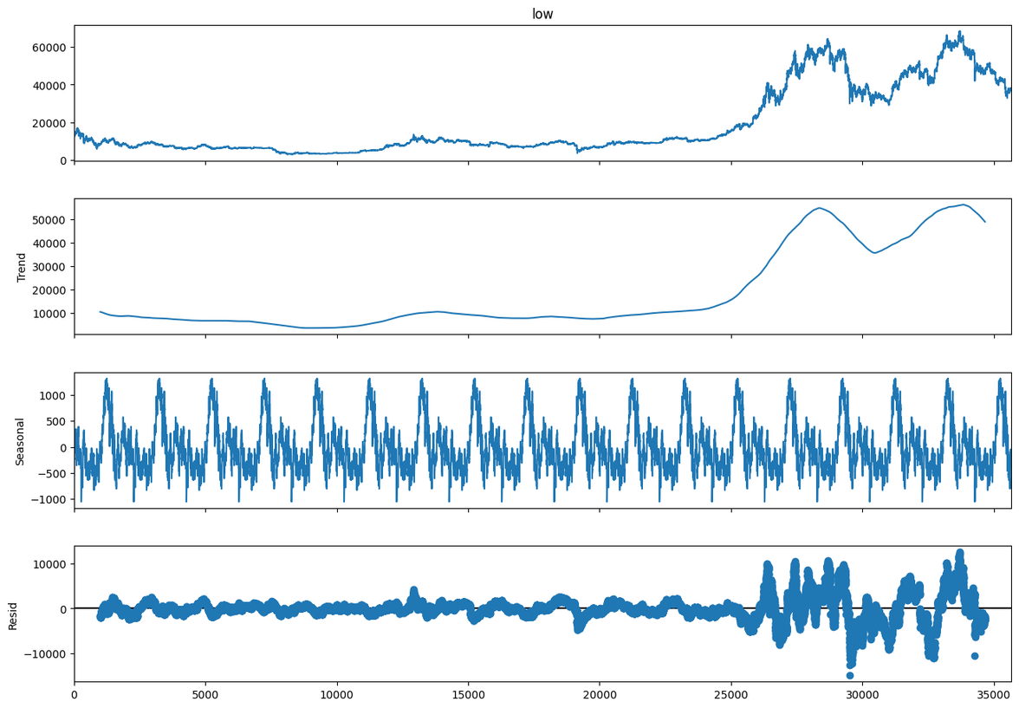
Exploratory Data Analysis
Seasonal Decomposition
A seasonal decomposition plot slices time series data into trend, seasonality, and noise
Seasonal Decomposition of OHLC dataset revealed that the prices follows a seasonal pattern and thus an approach which utilized seasonality was considered.

Slide 5
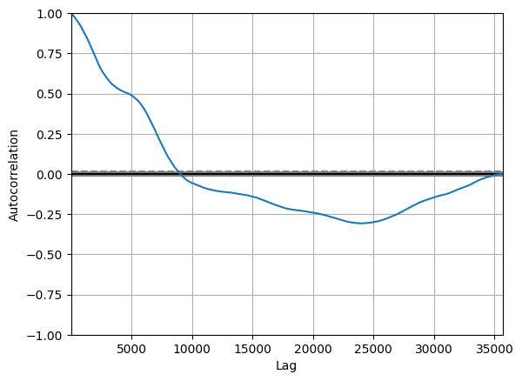
Feature Engineering
Autocorrelation measures the linear relationship between a time series data
and its lagged values, while partial autocorrelation quantifies the direct association between a time series and its lag, excluding indirect influences from shorter lags.
For training the Machine Learning Models we
created lag features starting from the lag 1 till lag 24. Since we trained the models
on 1 Hour timeframe data, we found that the
last 1 day of values were highly correlated
and thus we choose to use 24 period lag

Slide 6

Training ML Models

Slide 7
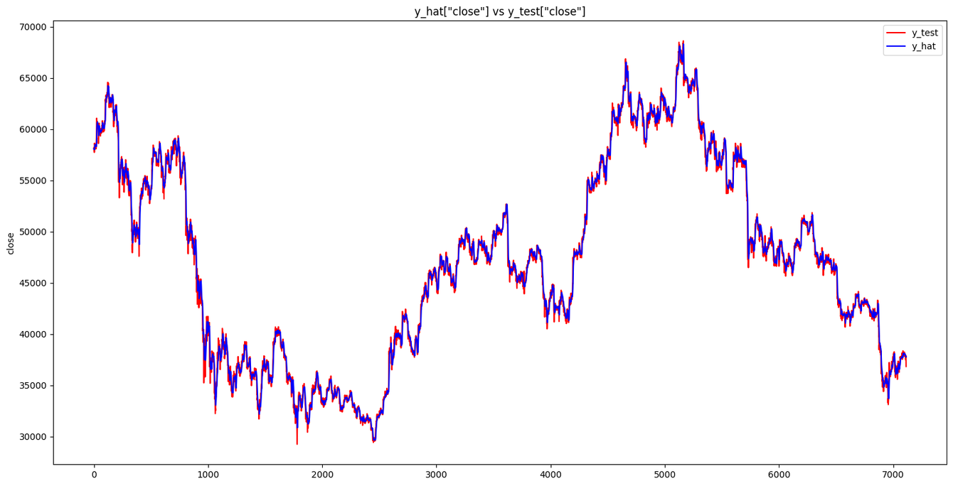



LSTM
Long Short-Term Memory (LSTM) networks are a type of recurrent neural network capable of learning order dependence in sequence prediction problems.
RMSE = 618.8062
Why LSTM?
Long-Term Dependencies
Handling Noisy Data
Variable Time Lags

Slide 8
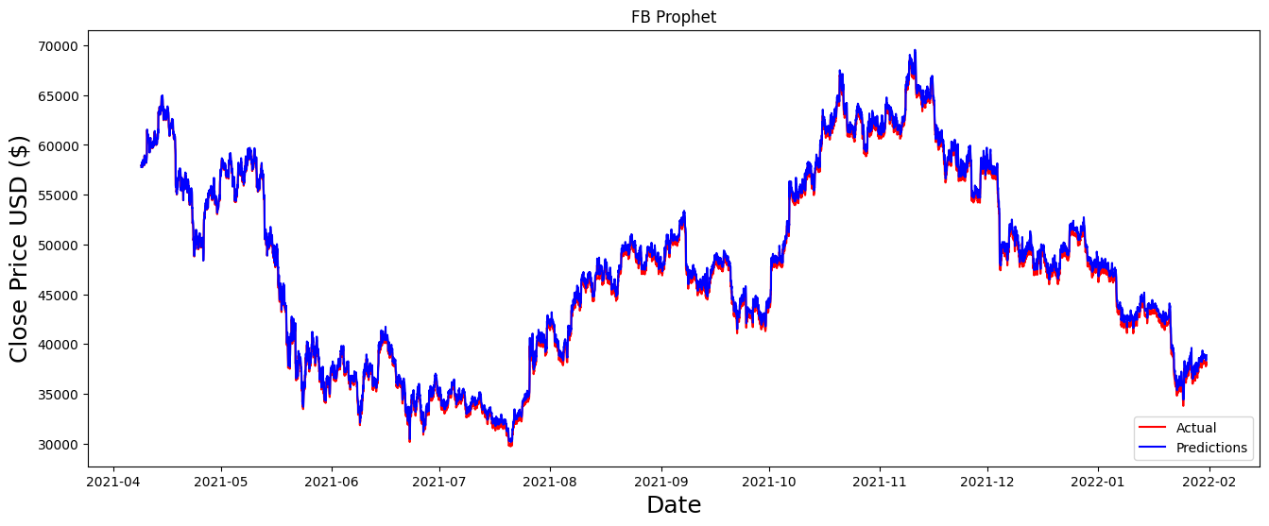
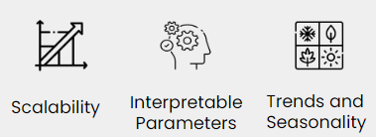
FB Prophet
Prophet accommodates known holidays or events by incorporating custom holiday dates and effects into the forecast. Its ease of use and its ability to handle irregularities and outliers in Data.
RMSE = 599.8186
Why FB Prophet?

Slide 9

Random Forest
A Random forest is an ensemble learning method that combines the predictions from multiple decision trees to produce a more accurate and stable prediction. It is a type of supervised learning algorithm that can be used for both classification and regression tasks.
RMSE = 1107.1096
Why Random Forest?

Slide 10
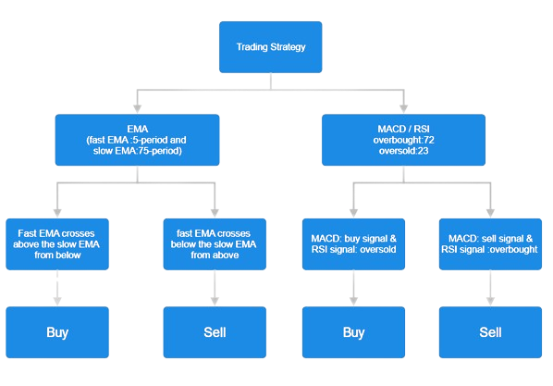
Trading Strategy
The strategy we implemented is a combination of two strategies which work in parallel with each other. First strategy is EMA crossover with a slow and fast moving EMA and then
MACD and RSI based strategy which looks for trades in oversold or overbought regions. By using two different strategies we were able to capture the market well.

Slide 11
Back Testing
 | 22866949.74
 | 22766949.74
 | 906
 | 27.04
 | -35.51
 | 6.67
 | 0.60
 | 22766.949
 | 172.22
 | -3.16
 | 20.09
 | 1.09
 | 8.36
 | 1 Day 11:00:00
Gross Profit
Profit (%)
Net Profit
Buy and Hold Return of BTC
Total Closed Trades
Largest Losing Trade(%)
Win Rate (Profitability %)
Largest Winning Trade(%)
Max Drawdown(%)
Sharpe Ratio
Risk Reward Ratio
Sortino Ratio
Average Holding Duration per Trade
Average Winning Trade

Slide 12
Risk Management
For effective risk management we set up a stop-loss order limit l and take profit limit which helped to manage the risk and finally we combinined different technical indicators to avoid false signals and thus lesser risk
In the strategy we used we used a stoploss of 3% from the entry price and a 20% take profit from the entry price.
After all the risk management techniques we obtained a reward
to risk ratio 20:3 of Employed RSI, MACD, and various indicators.
Ensures precise stop-loss levels..

